Slide 1



Zavvy Solution
Ms. Dashmeet Kaur
- Founder & CEO
Website - http://www.zavvysolutions.com/
Email –
info@zavvysolutions.com
We are here to give the best IOT service for leading INDIA.
IOT Products and Services Broucher-
Head Office
Sector – 37D, Chandigarh, Pin Code – 160036
Branch Office
Dwarka, Delhi, Pin Code – 110075
We are here to give you the customized products of Internet of things IOT related things and services.
We are India’s leading IOT service provider company.
This is the multiple service and sources under one roof we will giving to our clients and love to give them quality assurance.
Contact Us
+91 8587970235 / +91 8847248149
Notes:
To change this brochure, replace our sample content with your own. Or, if you'd rather start from a clean slate, press the New Slide button on the Home tab to insert a new page. Now enter your text and pictures in the empty placeholders. To change the logo to your own, select the picture “replace with LOGO” and choose Change Picture on the Picture Tools Format tab.
And did you notice we made fold marks for you? They are really light, but if you don’t like them showing on your brochure, select and delete them before you print.

Slide 2


IOT products & Services
Information -
“our company is the greatest. We provide best to do best.”
We are the best IOT service and products providers and we will also provide the free consultation of services and productions for the client satisfaction.
Once you use then realize that what we are giving .
.
Company Member
Why Zavvy for IOT -
Key offerings
Free Consultation
Can came to use for different suggestion , consultations, ideas, innovation and Service related information, product related information.
Contact to the above give contacts.
Feel free to reach.
Responsiveness
Quality Assurance
World Class Support
Guidance
Budget Friendly
Customization
Trust
Built In Analytics
Notes:
To change this brochure, replace our sample content with your own. Or, if you'd rather start from a clean slate, press the New Slide button on the Home tab to insert a new page. Now enter your text and pictures in the empty placeholders. To change the logo to your own, select the picture “replace with LOGO” and choose Change Picture on the Picture Tools Format tab.
And did you notice we made fold marks for you? They are really light, but if you don’t like them showing on your brochure, select and delete them before you print.

Slide 3
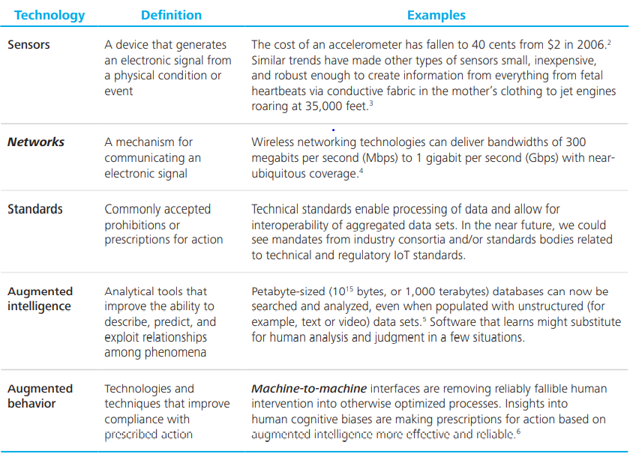
Facilities that we deliver -
Sensors
Networks
Standards
Augmented Intelligence
Augmented behaviour

Slide 4
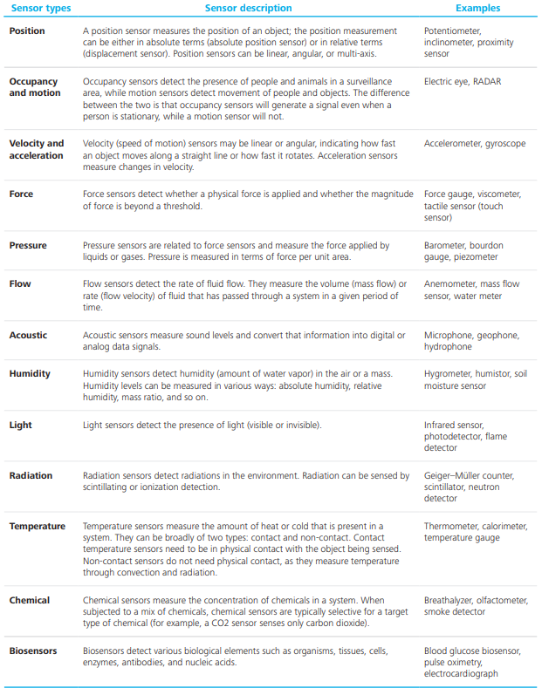
Sensors List
Types of sensors that we deal with –
Position
Occupation and motion
Velocity and acceleration
Force
Pressure
Flow
Acoustic
Humidity
Light
Radiation
Temperature
Chemical
biosensors

Slide 5
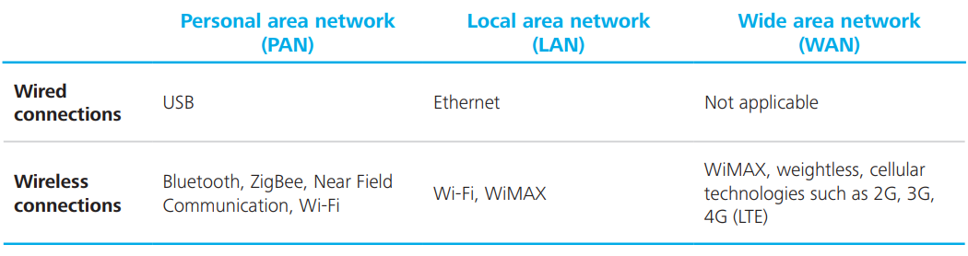
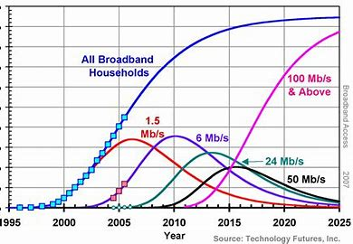
Networks
Our services are very much good in terms of -
Connectivity
Throughput
Availability
More control
Greater Efficiencies

Slide 6
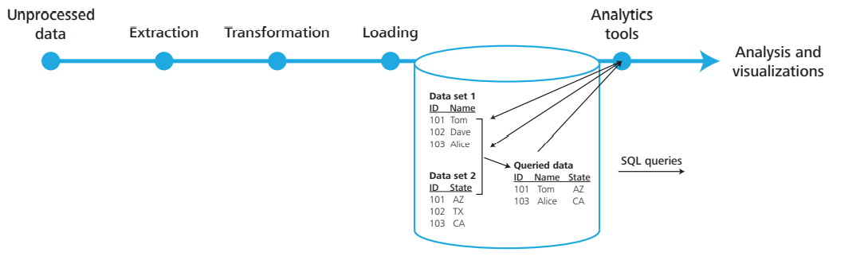
Standards
Communication protocols
Data aggregation standards
Standard for handling unstructured data
Provide Insides analytics
Data mining
Data visualization

Slide 7

Augmentation Behaviour
Home Automation
Industry Automation
Smart Gird
Wearable
Machine 2 Machine Interface based

Slide 8


HOME AUTOMATION Services -
Smart Lights
Smart Doors
Smart AC
Smart Alarm
Smart Home Theatre
Smart Door Locks
CCTV
Smart Scenes
Smart Energy Monitors
Smart Shade and Curton Control
This Photo by Unknown Author is licensed under CC BY-SA

Slide 9

Rules For Resellers 😎
👇 Read Carefully
✅ 1. You Have to Sale At least 5 License/Month
✅ 2. Initially You Have To Buy 5 License to Start Reselling
✅ 3. If Minimum Sales Target Will Not Met Then Your Reseller Account Will Permanently Deactivated
✅ 4. If We Found That, You Take Reseller Panel For Only Own Purpose Not For Selling, Then We Will Deactivate All Activate License & Panel Without Any Inform
.✅ 5. Do Not Share Your Reseller Keys Price with Anyone, If We Found This Then We Will Deactivate All Activate Licenses & Panel Without Any Inform.
✅ 6. No Full Version Keys Will Be Deleted, If You Created in Panel Then You Have Pay.
✅ 7. If Want to Create Reseller Under You Then You Have to Maintain Same Rules With Him.
✅ 8. We Dont Have Refund Policy.🔥 Benefits For Reseller 🔥✅ 100% Trust in Market
✅ No Investment, Life Time Earning.
✅ Latest & Unique Products
✅ No Boundary, Own Boss
✅ Ready to Use License CRM
✅ Technical Support to All Clients.

Slide 10

Website -
http://www.zavvysolutions.com/
Email –
info@zavvysolutions.com
Head Office
Sector – 37D, Chandigarh, Pin Code – 160036
Branch Office
Dwarka, Delhi, Pin Code – 110075
Contact Us
+91 8587970235 / +91 8847248149

